Slide 1
Ai Variant Internship programme
Project Name -: Customer churn classification

Slide 2
Group -: 1
Sr. No. | Name | Email-Id | Mob. No.
1 | Mr. Ajay Kumar Pandey | ajay3736pandey@gmail.com | 9451485515
2 | Mr. Sundaram A | sundar.sprinter@gmail.com | 9566937342
3 | Ms. Jeevikaa A | jeevikaaanand@gmail.com | 6369001722
4 | Ms. Sunaya Waghaye | sunayawaghaye004@gmail.com | 7057339577
5 | Mr. Rohit Bachotkar | rohitbachotkar75@gmail.com | 9373891123
6 | Ms. Achal Dhote | achaldhote2@gmail.com | 8308537512
7 | Ms. Sakshi Edalwar | sakshiedalwar23@gmail.com | 9130867451

Slide 3
Content-:
Project description.
Exploratory data analysis( EDA) & Feature engineering.
Oversampling technique.
Model building.
Model selection.
Deployment.

Slide 4
Project description -:
Customer churn is a big problem for telecommunications companies. Indeed, their annual churn rates are usually higher than 10%. For that reason, they develop strategies to keep as many clients as possible. This is a classification project since the variable to be predicted is binary (churn or loyal customer). The goal here is to model churn probability, conditioned on the customer features.
Each row corresponds to a client of a telecommunications company for whom it has collected information about the type of plan they have contracted, the minutes they have talked, or the charge they pay every month.
There are 5000 observations and 20 different features available in dataset.

Slide 5
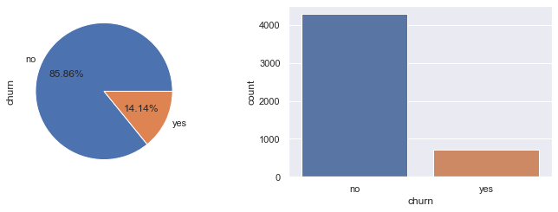
EDA & Feature engineering -:
Shape of the dataset – 5000 rows and 20 features
After describing the dataset there are some missing values in columns, so we replaced that values by mean and median.
There are some columns whose data types are object, so that’s converted to the its original data type.
Churn rate and count- 707 churn customers and 4293 are not churns

Slide 6
Checked customers area code wise and state wise.
We have dropped ‘State’ , ‘ area code’ , ‘ account length’ unused features from the dataset.
From 5000 customers only 26.46 % people activated there voice plan in that 7.70 % customers are churners.
From 5000 customers only 73.54 % customers not activated there voice plan in that 19.69 % are churners.
If customer did not activated voice plan there is 27% probability that customer will be churn
Or customer activated voice plan there is 27% probability that customer will be churn
If customer did not activated International plan there is 14% probability that customer will be churn
Or customer activated International plan there is 81% probability that customer will be churn
By analyzing data we can say that customers who calls more to customer care can be churn customer
We see that all the objects have two categories that is Yes and No, its also Known as binary distribution of data, so we are converting data yes - 1 and no – 0
After seeing correlation we get that some features are very high correlated to some features and most are independent in nature

Slide 7
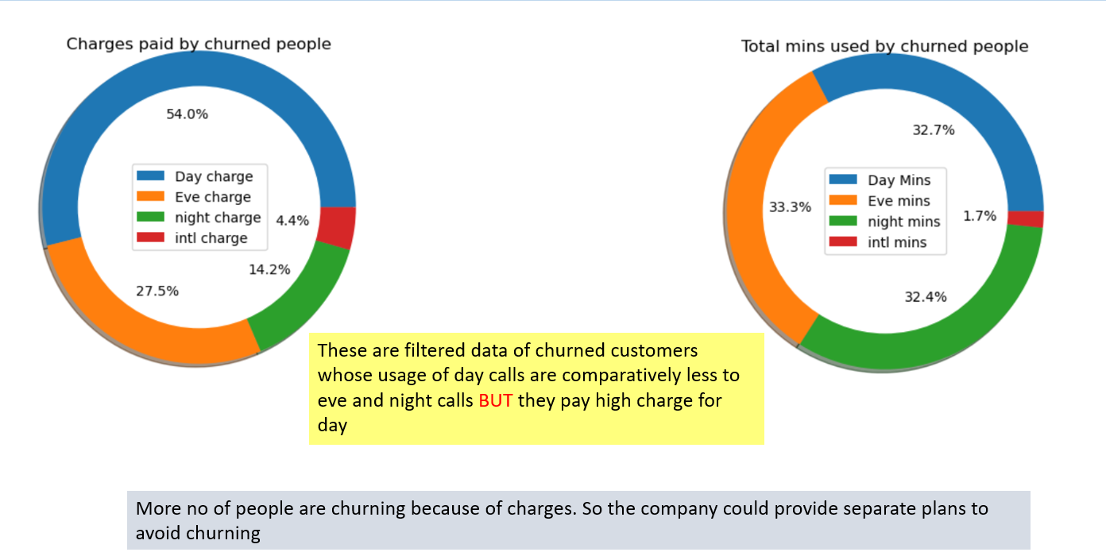
Total Charges and mins spend by churned customer

Slide 8
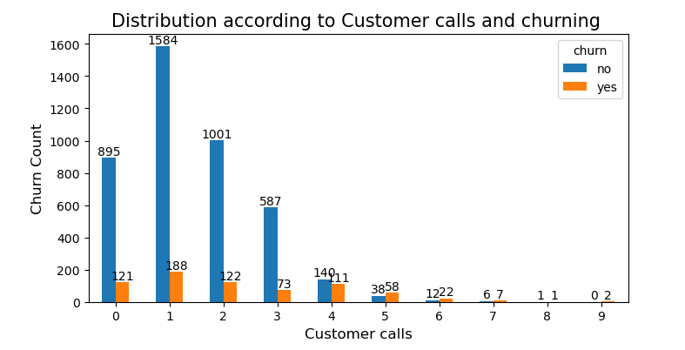
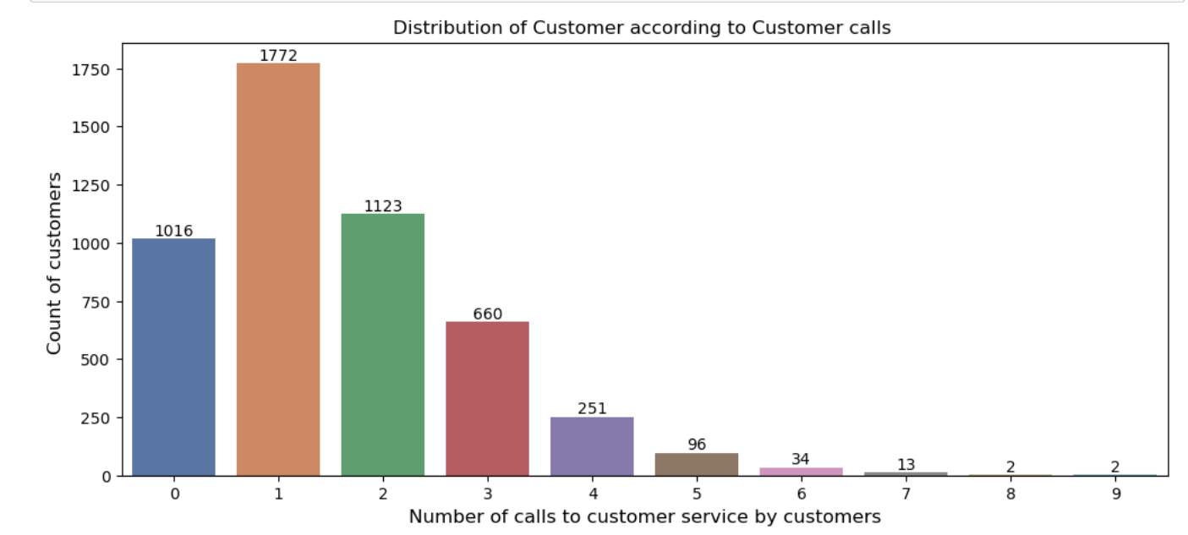
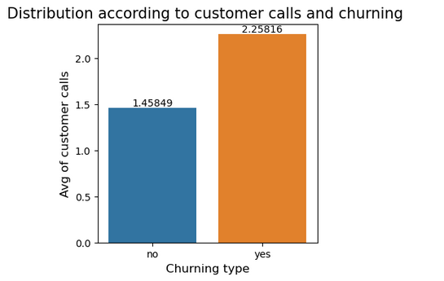
Churn rate according to customer calls
Customers who calls customer service is higher that those who are not calling customer service.
Churning rate is higher in Customer who calls for customer service.
Customer who are calling 5th and 6th time for customer service are churning more.

Slide 9
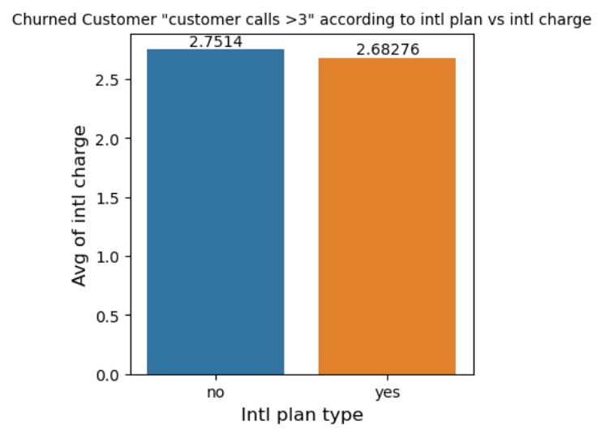
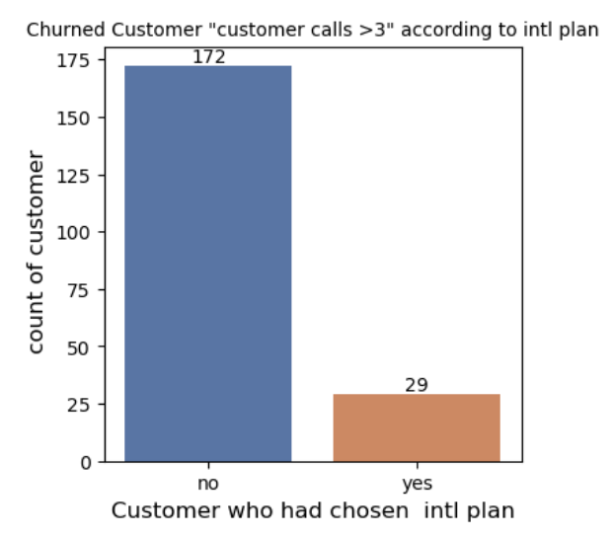
Churned Customers with calls > 3 customer calls
Customer call > 3
Count of cust calls >3
The filtered data of customers who calls customer service more than 3 times shows that they pay intl chares even though they didn’t opt for intl plan

Slide 10
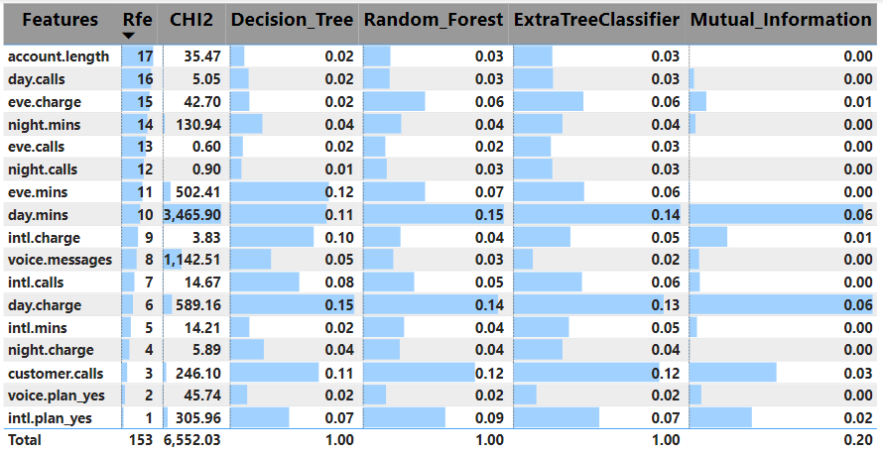
Feature Selection
For feature selection we used RFE(Recursive feature elimination), CHI2, Decision_Tree, Random forest, Extratree_Classifier and Mutual information were used.
In comparison with all, important features are day mins, Day charge, Customer calls and Intl calls.
But in reference with RFE→ Intl plan, voice plan and customercalls are more important
The least important is Account length, day calls, Eve charge and calls, night charge and calls

Slide 11
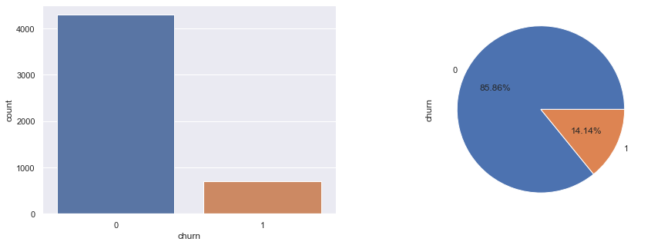
Oversampling technique -:
while seeing the plot and number of counts we get that data is imbalanced
After using Oversampling technique to balance the data set-
Oversampling techniques create new datapoints of minimum target variable and increase the data up to maximum target variable.

Slide 12
Model building -:
Our problem statement is to predict churn customers its a classification problem so we are using machine learning supervised classification algorithms and find which model is giving best results
1. Logistic regression
2. Decision tree
3. Random forest
4. Support vector machine
5. Naive bayes
6. Gaussian Naïve Bayes
7. K - Nearest Neighbour
8. XGBM
9.LGBM
10.AdaBoost

Slide 13
MODEL ACCURACY
Normal dataset
Oversampled dataset
Smoted Dataset

Slide 14
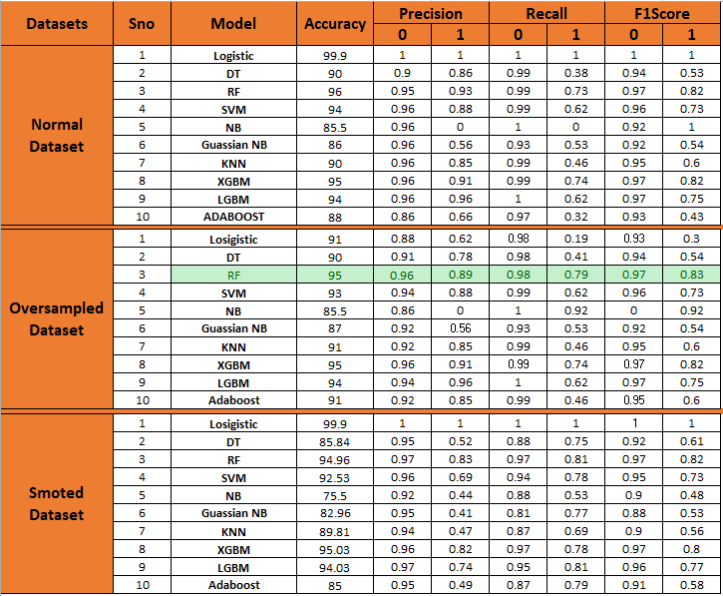
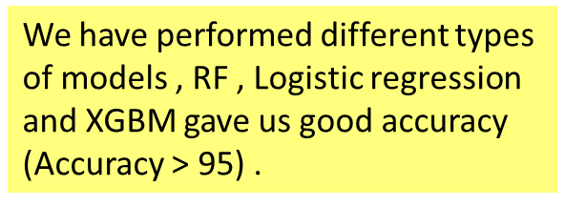
DEPLOYED MODEL ➔Oversampled: RF

Slide 15
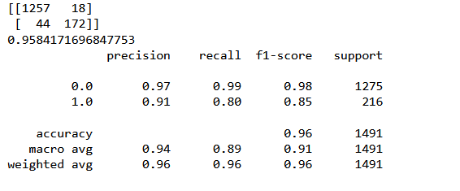
Model selection -:
Our All Models are very capable to predict Not Churns Customers.
But when its time to predict churns customer some model perform so much bad and some perform good.
While seeing there f1 Score we get that random forest model is performing so much better than other for predicting Churn customers and Not Churn Customers.
As we See Random forest is performing best to our dataset so we are deploying this model

Slide 16
Deployment -:
After you have a set of models that perform well, you can operationalize them for other applications to consume. Depending on the business requirements, predictions are made either in real time or on a batch basis. To deploy models, you expose them with an open API interface.
Libraries used for deployment -
a)Stream lit b)pickle c)sklearn.ensemble
Then custom defined function created to take all inputs for the prediction.
By using stream lit service we get the interface for the prediction

Slide 17
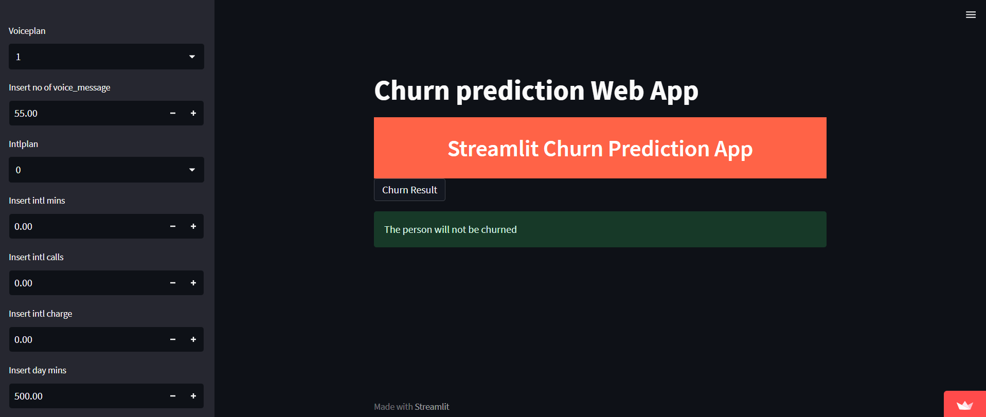
Final output -:
https://sundaramayyappan-deploy-app-0z6ayu.streamlit.app/
https://jeevikaaanand-churn-app-48yi12.streamlit.app/
https://ajay3736pandey-churn-prediction-churn-prediction-web-app-1gv1m2.streamlit.app/

Slide 18
Thank You…

